Slide 1
Communicative English Faculty – Dr. Kiran Magavi Department – Humanities and Social Sciences
Phonetics

Slide 2
Topics of discussion
Sounds
Syllables
Word stress
Sentence Stress
Intonation

Slide 3
Areas of focus
Basics of Phonetics and Phonology of English
Importance of stress, rhythm and intonation
How stress rhythm and intonation change the meaning of a word, sentence or a message
Certain situations in which meaning of a word or sentence has changed due to spoken features
Acquire a good pronunciation of English

Slide 4
Sounds
Vowels:
During the production of all the English vowels: a, e, i, o, u
the soft palate is raised, and
the vocal cords vibrate
The above articulatory features distinguish different vowel sounds and determine the vowel quality

Slide 5
Types of vowel sound
Monophthong - a vowel sound whose quality doesn't change over the duration of the vowel. It is also called pure or stable vowel
Diphthong - a vowel sound that glides from one quality to another

Slide 6
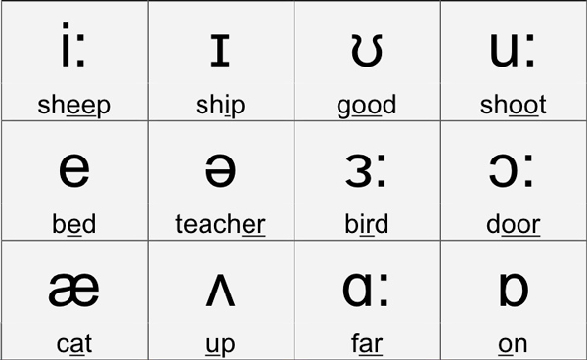
Monophthongs or Pure vowels

Slide 7
Diphthongs
Two vowels produced consecutively in the same syllable by moving the articulators from one position to the other.
Example: Fly: flai- 1 syllable word-ai

Slide 8
Diphthong Examples
/eI/ brain, great, neighbour
/aI/ site, shy, eye
/ɔI/ employ, oil, coy
/əʊ/ oval, fold, know
/aʊ/ owl, mountain, cloud
/Iə/ ear, beard, appear
/eə/ compare, hair, stair
/ʊə/ poor, jury, endure

Slide 9
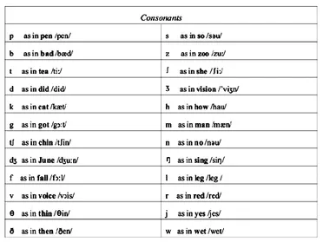
English Consonants
A consonant is a speech sound which obstructs the flow of air through the vocal tract.
There are 24 consonants in standard British English

Slide 10
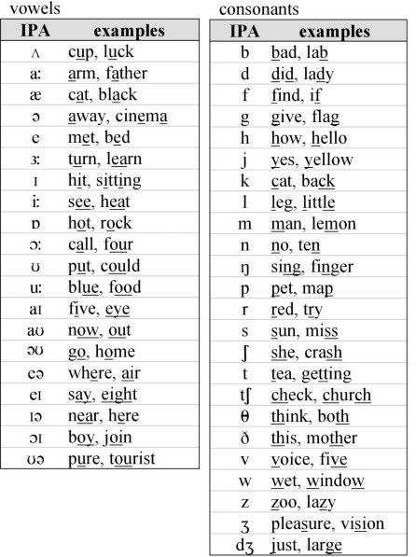

Slide 11
Syllables
The number of vowel sounds in a word equals the number of syllables. Every syllable must have a vowel sound.
For example:
can, win-dow, mag-ne-tic
Words are divided in to three types as per number of syllables:
1. Monosyllabic: Words with one syllable e.g. on- on (VC)
2. Disyllabic: Words with two syllables e.g. upon- up+ on (VCVC)
3. Polysyllabic: Words with more than two syllables e.g. syllable – sy+lla+ble (CVCVCVC)

Slide 12
Accent/Stress
Stress is the first vocal feature to be analyzed.
Speakers need to stress some syllables while speaking.
If they do not do it, words will be misunderstood or sound strange.
Stress is used in all languages whether, Hindi or English or Spanish.
Notice the differences in the following sentences:
I need a permit to go to the other state
The teacher did not permit me to leave the class.
My sister will present you with a present.
I won’t clean the garden.
I won’t clean the garden

Slide 13
Word Accent
Word accent or stress is the relative degree of prominence with which different syllables of a word are pronounced.
For example:
1. pro-mi-nent 1st syllable is accented
2. per-cieve 2nd syllable is accented
3. in-ca-pa-ci-tate 1st & 3rd syllables are accented
4. pro-nun-ci-a-tion 2nd & 4th syllables are accented

Slide 14
Features of Word Accent
It’s longer.
It’s louder.
It’s clearer.
It has a higher pitch.
It involves more movement of your mouth and lips to make the sound
Accent is a manner of pronunciation peculiar to a particular individual, location, or nation. The region to which you belong affects your accent. Not only the locality but the economic status, ethnicity, etc. all make an impact on the accent. Accent mainly includes pronunciation, which also has correlation with stress.

Slide 15
The quality of speech depends on-
1. Pitch: (Loudness)
Pitch is a property that allows the ordering of sounds on a frequency-related scale. Pitches are compared as "higher" and "lower".
2. Rhythm: (Sound pattern achieved by using stress in words)
Rhythm refers to a pattern of sounds
3. Intonation: (variation of pitch or loudness of the words in a sentence)

